Slide 1

Namal Blood Bank Management System (NBBMS)
Team Members: Muhammad Asim Khan, Umair Ahmad, Ayesha Tahir
Supervisor: Mam Asiya Batool
• Team Members: Muhammad Asim Khan, Umair Ahmad, Ayesha Tahir
• Supervisor: Mam Asiya Batool

Slide 2
Introduction
Project Overview:
The NBBMS is designed to streamline blood bank operations, ensuring efficient management of blood donations and supplies.
Objectives:
Improve the management of blood banks.
Facilitate easy access to blood bag information.
Enhance tracking of donors and recipients.

Slide 3

Project Motivation
Background:
Blood wing of NSSI socity in our Namal university has no database.
Manual processes lead to errors and delays.
Need for the Project:
A database connected with website can enhance accuracy and efficiency of the data of NSSI Blood Wing.
It ensures timely availability of blood for patients in need.

Slide 4
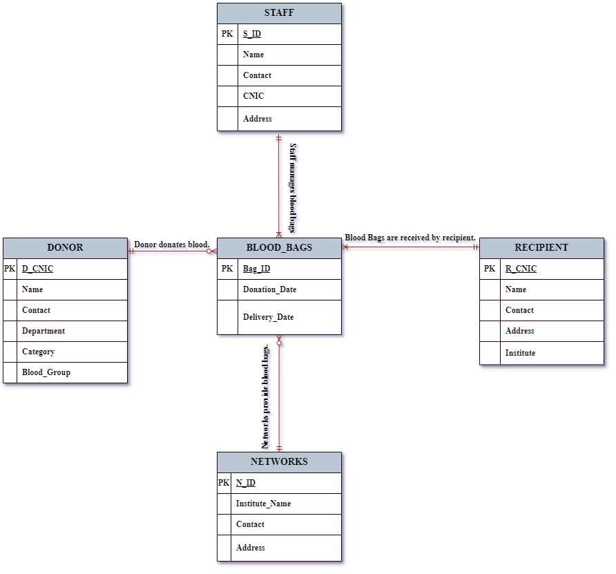
NDBMS ERD

Slide 5
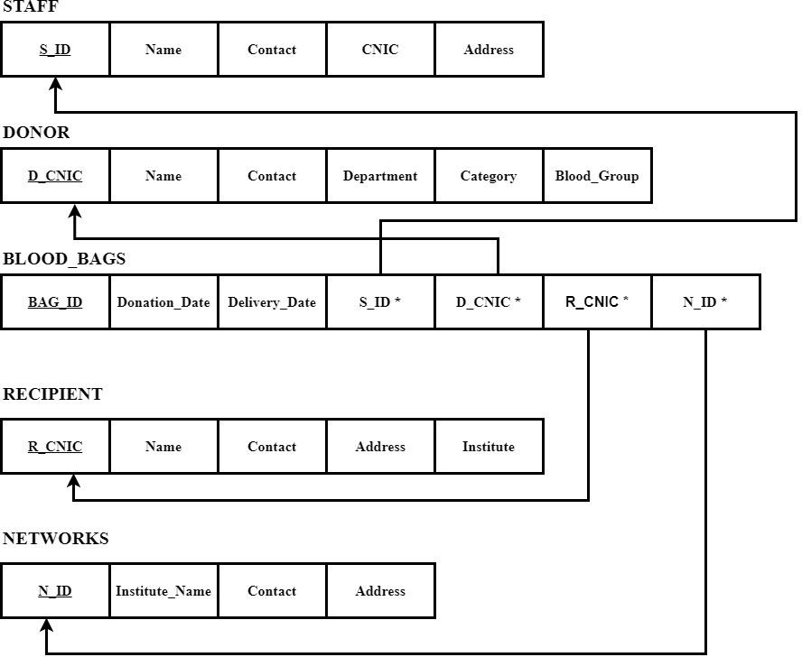
RELATIONAL SCHEMA

Slide 6
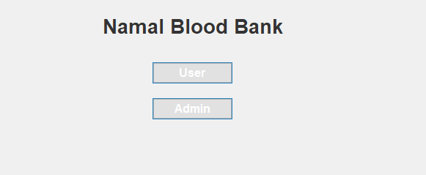
Website Interfaces
1. Admin Interface:
Functionalities such as searching, adding, modifying, and deleting records.
2. User Interface:
Functionalities like viewing available blood bags and searching for donors by blood group.

Slide 7
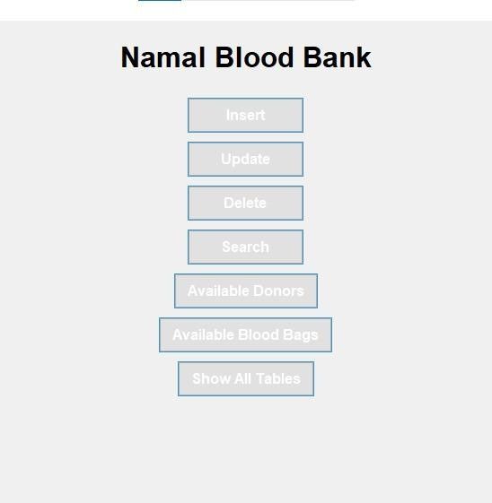
Admin Interface

Slide 8
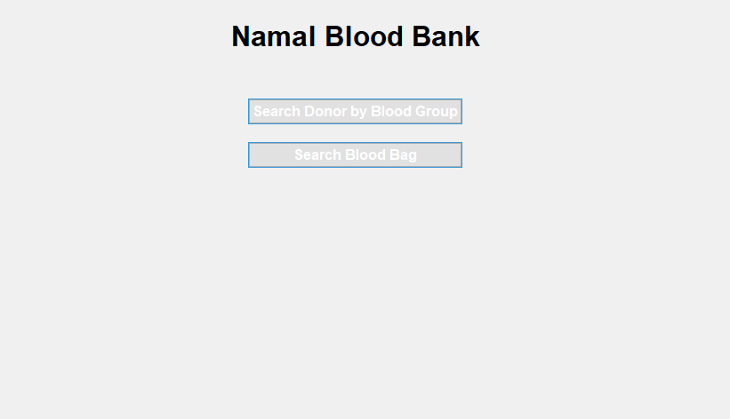
User Interface

Slide 9
Implementation
Development Process:
Overview of development stages and methodologies.
Tools and Libraries:
Python libraries (MySQL-connector-python, Tkinter, subprocess).

Slide 10

Future Work
Improvements:
mobile-friendly interfaces
New Features:
New features for future development
Security:
Random key will be added to make database security more strong password.

Slide 11

Any Question

Slide 12
Thank You

